Slide 1

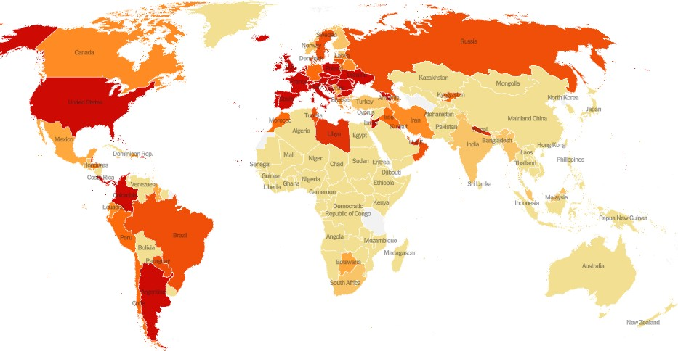
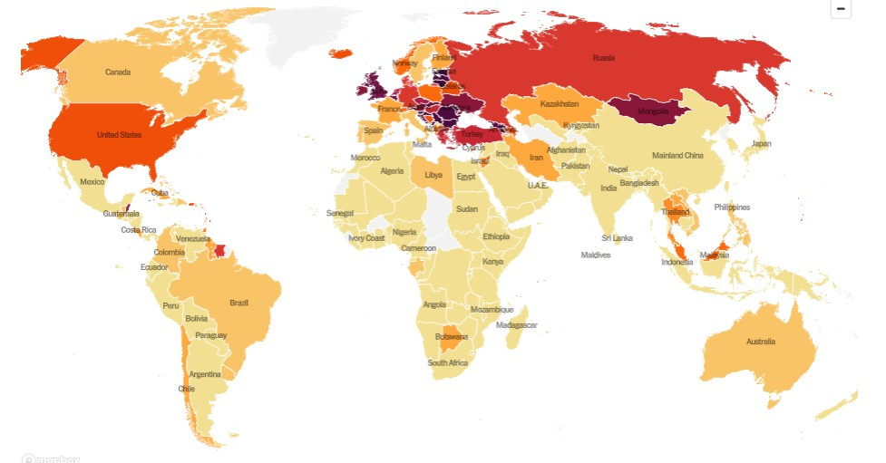
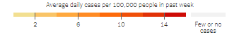
Representation
Universidade de Aveiro Departamento de Electrónica, Telecomunicações e Informática
https://www.nytimes.com/interactive/2021/world/covid-cases.html
Beatriz Sousa Santos, University of Aveiro, 2021

Slide 2
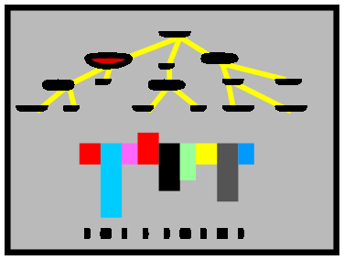

Data
andgain insight
We look at thatpicture
Ah HA ! !
Information visualization
The process of information visualization: graphically encoded data is
viewed in order to form a mental model of that data (Spence, 2007)
2

Slide 3
HIGHER-ORDER COGNITIVE
PROCESSES
Problem (re)formulation Evaluation of options
Strategy formulation Internal modelling
etc.
REPRESENTAT ION of data
DATA
PRESENTATION of the
represented data
PERCEPTION
INTERPRETATION
INTERACT ION to select the required view of data
Decision making
The scope of this book
(Spence, 2007)
Interaction with data governed by high-order cognitive processes:
Representation (how to code visually the data)
Presentation (what/when/where to show on the screen)
Interaction (how to let users explore the data)
3

Slide 4
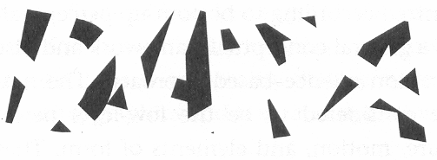
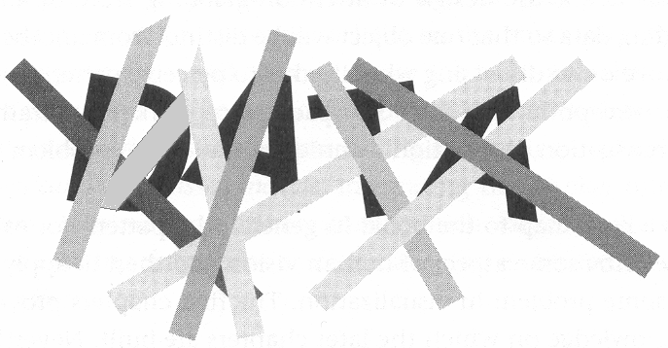
Remember:
The Human Visual system is the product of millions of years of evolution
Although very flexible, it is tuned to
data represented in specific ways
If we understand how its mechanisms
work we will be able to produce better results
4

Slide 5

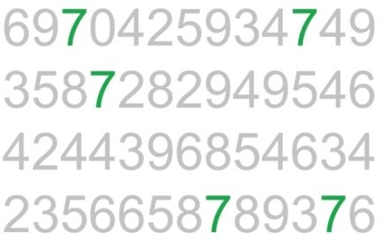
Pre-attentive attributes can help observers to see before though
Example: Count the number of 7s
https://www.youtube.com/watch?time
_continue=121&v=AiD6etOB6qI
5

Slide 6
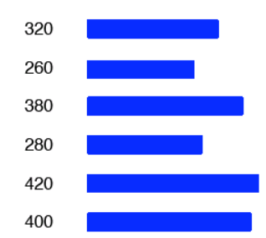

Other visual attributes as size, proximity are also quickly processed by
visual perception, before the cognitive processes come into play
Example: mapping numerical values to the length of bars:
320
260
380
280
(Mazza, 2009)
10

Slide 7
Procedure to follow to create visual representations of abstract data
Define the problem and the users’ questions
Examine the nature of the data to represent and pre-process the data
Determine the number of attributes
Choose the visual structures
Establish the type of interaction
test several ideas …

Slide 8
communicate explore confirm
nature of the problem
quantitative ordinal categorical
nature of the data to represent
univariate bivariate trivariate multivariate
Next: representation methods organized according the n. of attributes
number of attributes
linear
temporal
spatial or geographical hierarchical
network
data structures
,
static
type of interaction transformable
manipulable

Slide 9
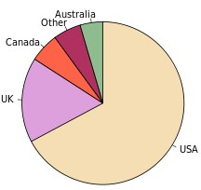
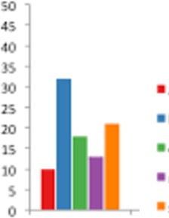
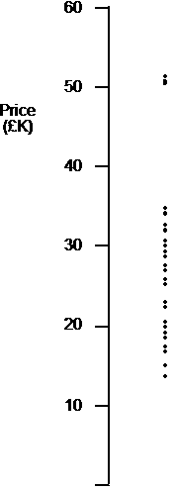
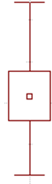
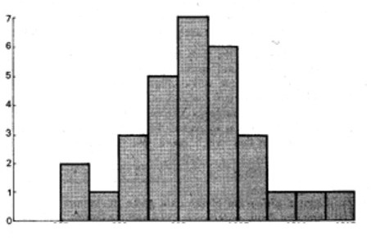
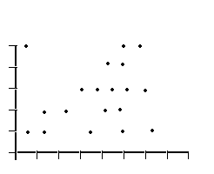
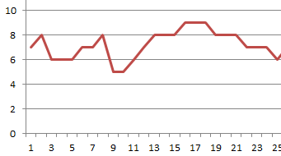
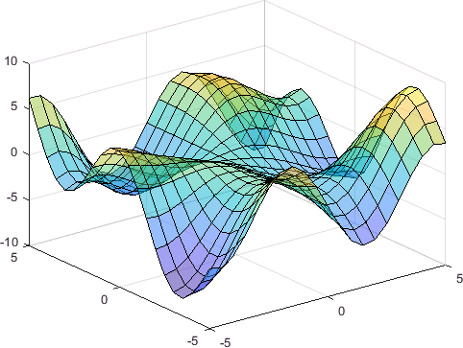
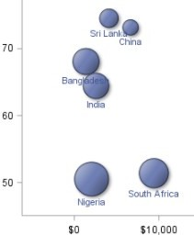
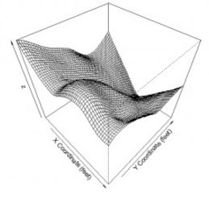
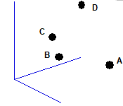
Common Visualization Techniques
for univariate, bivariate and trivariate data
Univariate data
dot plot box plot bar chart histogram pie chart
…
Cherries Apples Kiwis Grapes Oranges
x
Bivariate data
scatter plot line plot time series
…
y
x
t
Trivariate data
surface plot contour plot
3D representation
bubble plot
…
y
z
15
x

Slide 10
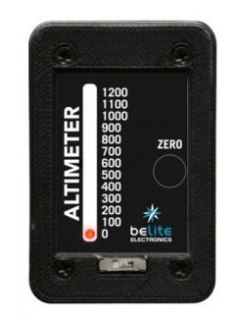
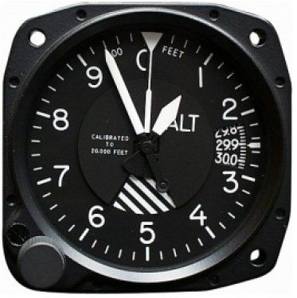

Representing univariate data
A single number can be difficult to represent
ensuring a user is made aware of it
Example: the altimeter
(Spence, 2007)
2200
2000
₁₈20
00
1600
1400
stop
1200
The original type of aircraft altimeter, with usability issues
Two altimeter representations easily assumed to be the same due to change blindness
A more usable solution for altimeter display

Slide 11
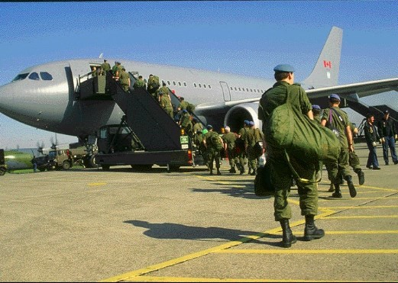
Some more examples on how humans see…
Example of change blindness
(Spence, 2007)

Slide 12
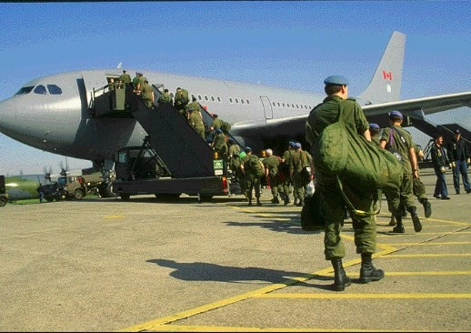
Example of change blindness
(Spence, 2007)
What is missing now?

Slide 13
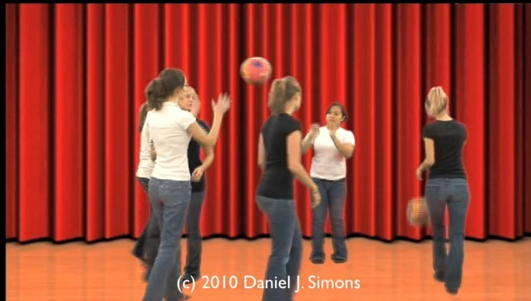
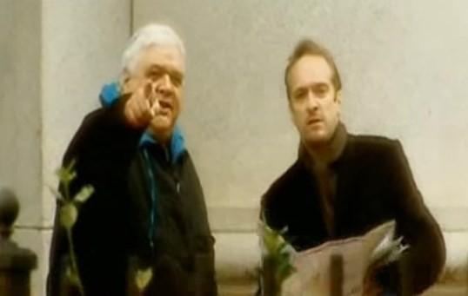
Inattentional blindness
https://www.youtube.com/watch?v=IGQmdoK_ZfY
Change blindness
http://www.youtube.com/watch?v=vBPG_OBgTWg&feature=related

Slide 14
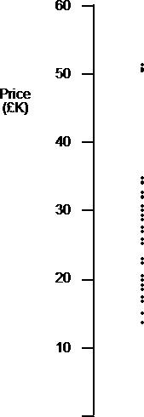
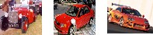
Representing univariate data (cont.)
A more common situation consists in representing a set of values
Dot plot Tukey boxplot
Well established techniques exist
60
But new ones can be invented!
50
Price (£K)
40
Example:
30
Price for a number of cars:
dots on a linear scale
box plot
20
(that will answer many questions:
median value, outliers,...)
10
(Spence, 2007)
https://www.data-to-viz.com/caveat/boxplot.html

Slide 15

8
much of the data is aggregated
6
precise detail is often not needed
4
We can represent derived values
2
The histogram is a well known technique representing derived values
10-2 0 20-3 0 30-4 0 40-5 0 50-6 0
Price (£K)
Tipping over the bars of the histogram a bargram is obtained
(Spence, 2007)
Price £k
10 - 12 |  | 12 - 14
16 - 18
Missing characteristic:Empty bin
Categorical or ordinal data can also be represented in bargrams
Nissan Ford Ferrari MG Cadillac
21

Slide 16
Simple (and common) representations of data
Two common techniques not to be confused !
Histogram Bar chart
represents a distribution of numerical data
represents the number of occurrences of a categorical/ordinal
data
Both represent data by rectangular bars(vertical or horizontal) with length proportional to the values they represent
Fruit production
Tons
Marks of the Exam
Cherries Apples Kiwis Grapes Oranges
Bins
0-2 3-4
(mark)
5-6 7-8 9-10 11-12 13-14 15-16 17-18 19-2

Slide 17
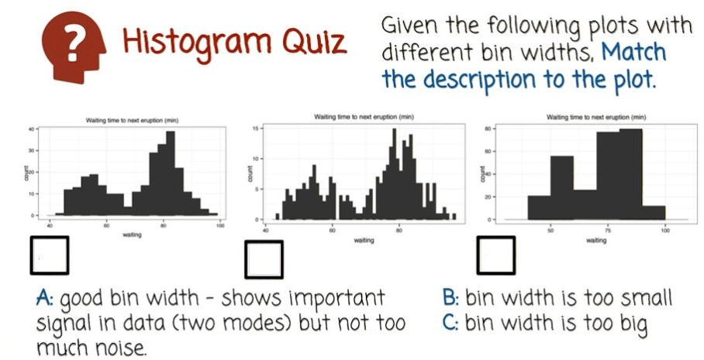
23

Slide 18
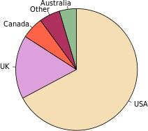
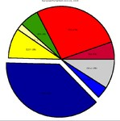

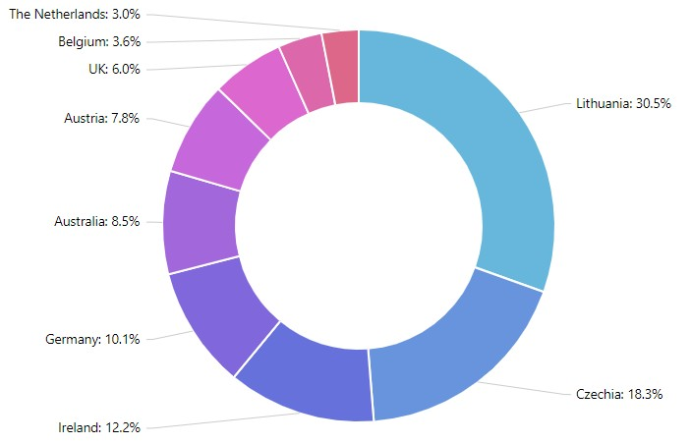
Another simple (and too common) representation
Pie Chart
Represents numerical proportion, parts of an whole
Native English speaking population
The arc length of each slice (its central angle and
area), is proportional to the quantity it represents
Variations of pie charts:
Are much controversial:
many experts recommend avoiding them
http://www.perceptualedge.com/articles/08-21-07.pdf
It is difficult to compare different sections of a pie chart, or to compare data across different pie charts
24

Slide 19
Simple criteria to determine whether a pie chart is acceptable
Consider it only if:
The parts make up a meaningful whole
The parts are mutually exclusive
There are <6 parts and slices have not very different sizes
If the main purpose is to compare between the parts,
use a different chart!
https://eagereyes.org/techniques/pie-charts
25

Slide 20
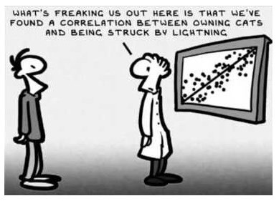
Representing bivariate data
The scatterplot is the conventional representation
Each observation is represented by a point on a two dimensional space The axes are associated with these two attributes
This representation affords awareness of:
general trends
local trade-offs
outliers
Correlation is not causation
27

Slide 21
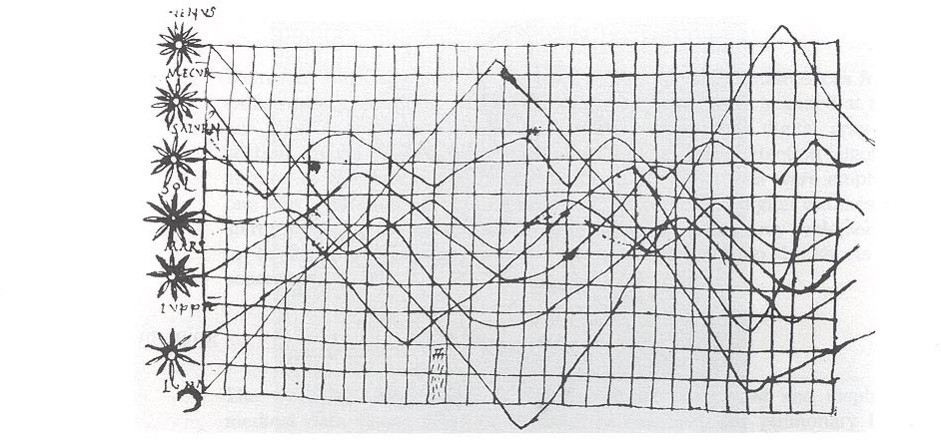
Representing bivariate data
The line chart
One of the oldest known and ubiquitous Visualizations
Inclination of orbits along the time - Xth century (Tufte,1983)
28

Slide 22
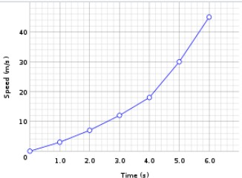
A line chart or line plot or line graph or curve chart displays information as a series of data points called 'markers' connected by straight line segments
Basic type of chart common in many fields
Often used to visualize a trend
in data over intervals of time
29

Slide 23
If one attribute is more important than the other or must be examined first,
it may be appropriate to employ logical or semantic zoom
60
Example:
50
40 35 30 |  | Ford Nissa n VW M erc Jag Jag Ford SE AT
Pri ce (£ K)
Analyzing a list of cars:
40
- price is the first attribute to examine
30
20
- semantic zoom reveals data about a second attribute
10
(Spence, 2007)
This technique is quite general: it can encompass many attributes and many levels of progressive zoom
30

Slide 24



Representing Trivariate data
Since we live in a 3D world, representing trivariate data as points in a 3D
space and displaying a 2D view is natural
D
However, these representations
can be ambiguous
Price
C
This can be solved by interaction, allowing the user to reorient the representation
B
Bedrooms
A
“for 3D to be useful, you’ ve got
to be able to move it”
(Spence, 2007)
Time
32

Slide 25
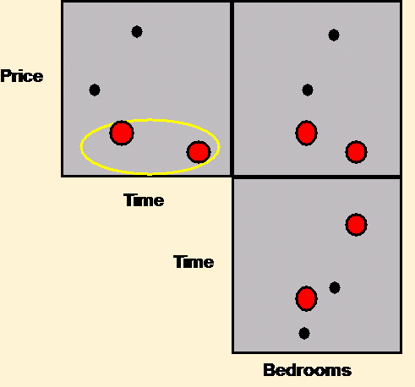
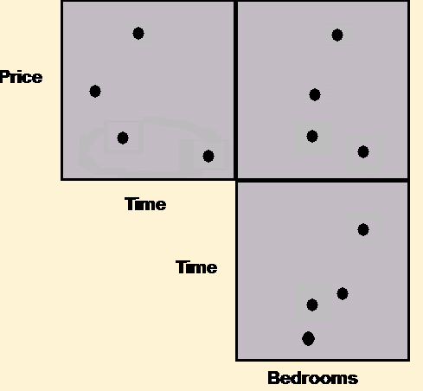
Interaction (brushing) can help – objects identified in one view are highlighted in the other two planes
change blindness must be taken into account and ensure that the user notices the highlight in the other two planes
(Spence, 2007)
The highlighting of houses in one plane is brushed into the remaining
planes.
33

Slide 26
An alternative representation for trivariate (and hypervariate) data is a structure formed from the three possible 2D views of the data
Example: houses (price, number of
bedrooms, time of journey to work )
Scatterplot matrix
D
Price
C
B
Bedrooms
A
Bedrooms
Time
A
D
(Spence, 2007)
B
C
Price

Slide 27
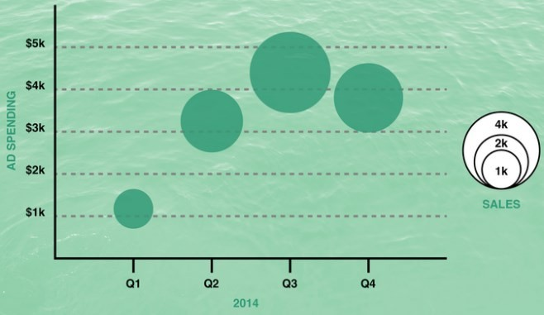
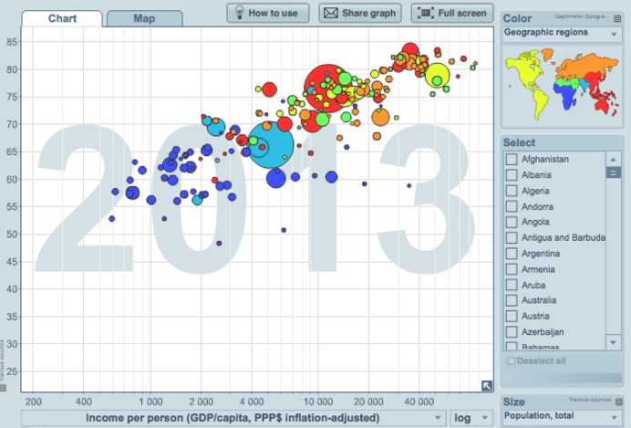
Other Simple (and common) representation of 3D data
In a bubble chart data are represented as a disk that expresses two of the values through the disk's xy location and the third through its size (radius or area?)
Mapping the variable to size must be done carefully. The interpretation of size may be ambiguous
Representing one more dimension through color
https://visage.co/data-visualization-
101-bubble-charts/
35

Slide 28
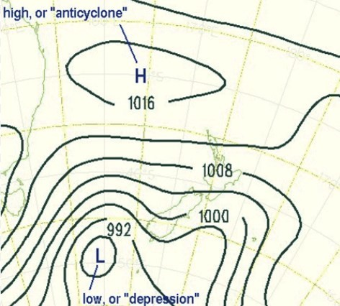
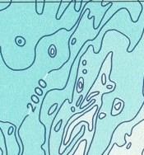
Simple representations of a function (field) of two variables
Contour plots
contour line (also isoline, isopleth,
or equipotential curve) of a function of two variables is a curve along which the function has a constant value, so that the curve joins points of equal value.
Typical in meteorological charts (isobars and isothermal curves)
and maps (to represent altitude or depth)

Slide 29
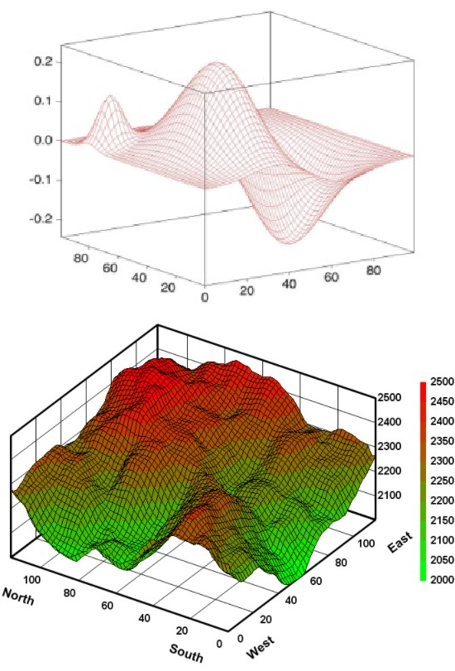
Surface plots
May be combined with color (preferably in a redundant way and
carefully selecting the scale)
37

Slide 30
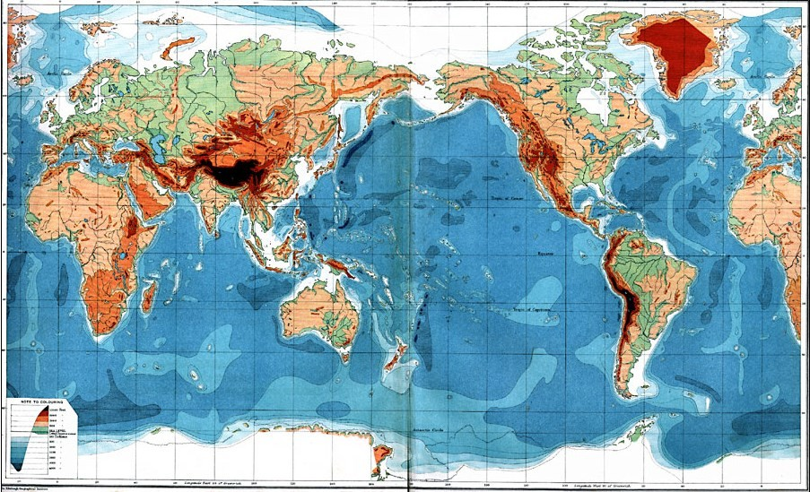
A special category of trivariate data: Maps (latitude and longitude + a value)
1915 – Orographic Chart of the World
https://etc.usf.edu/maps/pages/100/167/167.htm
38

Slide 31
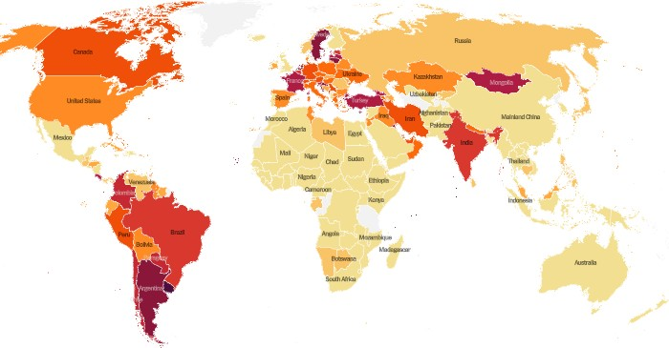

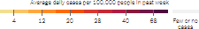
Choropleth maps - A standard approach to communicating aggregated
data by geographical areas using color encoding of the geographic area
They require some care: what are the possible issues?
October/30/2021
https://www.nytimes.com/interactive/2020/world/coronavirus-maps.html
39

Slide 32
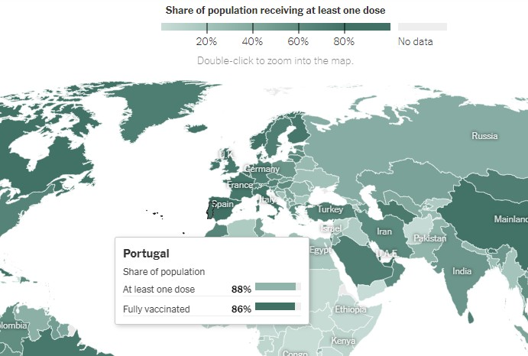
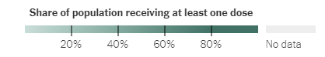
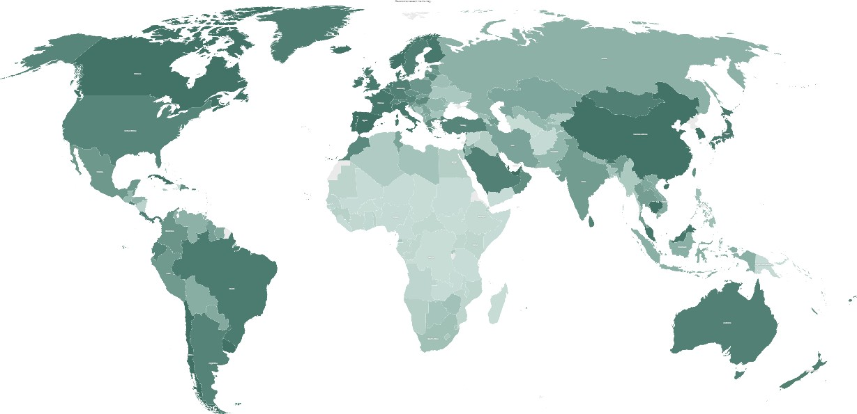
How can these issues be mitigated?
Covid vaccination worldwide
(choropleth + details on demand)
https://www.nytimes.com/interactive/2021/world/covid-vaccinations-tracker.html

Slide 33
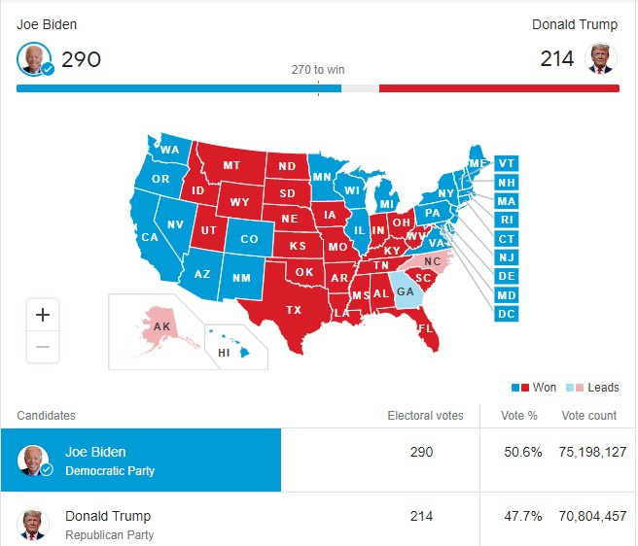
Visualizations of the US 2020 Election
(choropleth + bar)
43

Slide 34
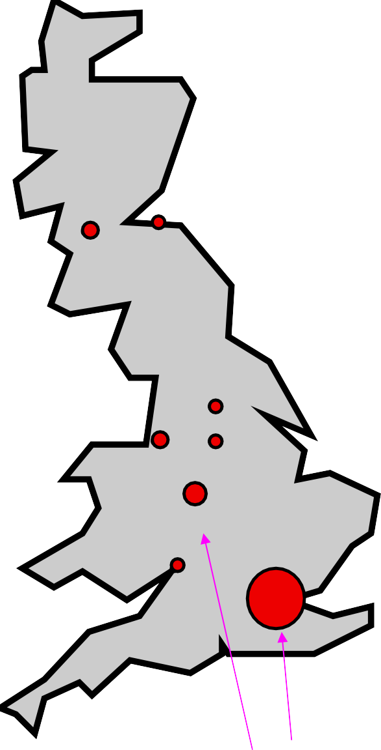
Some more examples on how humans see…
Population of major cities in England, Wales and Scotland. Circle area is proportional to population. (Spence, 2007)
Things that “pop-out”

Slide 35
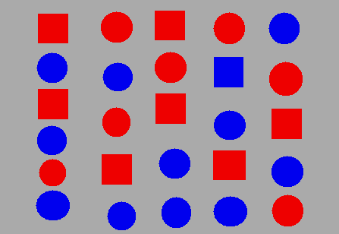








Pre-attentive processing: Things that “pop out”
“We can do certain things to symbols to make it much more likely that they will
be visually identified even after a very brief exposure” (Ware, 2004)
Orientation
Colour
Where is the blue square?
(Spence, 2007)
But we should be careful…
Shape
Enclosure

Slide 36

Color is a strong visual cue
How many cherries?
(Ware, 2004)
47

Slide 37

Color is a strong visual cue: it may help users perform their tasks
If correctly used
How many cherries?
Color may support users in many tasks! Or not ...
48

Slide 38


Color may not help or even make it more difficult!
A B
A- no preattentive association that allows efficiently determine the values (Kirk, 2012)
B- a single hue and a sequential color scheme representing values in an immediately understandable way
49

Slide 39

The misuse of colour in science communication
https://www.nature.com/articles/s41467-020-19160-7
50

Slide 40




Remember:
Not everyone sees color:
The most common form of color blindness is deuteranopia (“daltonism”)
There are color blindness simulators
/
Normal vision
Deuteranopia
http://www.color-blindness.com/coblis-
color-blindness-simulator
Tritanopia
http://www.colourblindawarene5s1s.org/

Slide 41
Representing Hypervariate (or multivariate) data
Many real problems are of high dimensionality
(even after reducing dimensionality…)
The challenge of representing hypervariate data is substantial and continues
to stimulate invention
Some of the mentioned representation techniques can be scaled to represent
hypervariate data (to a limited extent)

Slide 42







Techniques for Hypervariate (or multivariate) data Visualization
Coordinate plots
parallel coordinate plots
star (or radar) plots
Scatterplot Matrix
Maps
Mosaic Plots
Icons

Slide 43


Parallel coordinates plots are one of the most popular techniques for hypervariate data
…
They have a very simple basis
…
(Spence, 2007)
54

Slide 44








Nu mber of bedrooms
A
Consider a simple case of bivariate data:
B
1- A scatterplot represents the price and number of
bedrooms associated with two houses
Price
2- the axes are detached and made parallel; each house is represented by a point on each axis
Price
Nu mber of bedrooms
B
3- To avoid ambiguity the pair of points representing a house are joined and labeled
A
Price
Nu mber of bedrooms
55

Slide 45
A example for six objects, each characterized by seven attributes:
For objects characterized by many attributes the parallel coordinate plots offer many advantages
objects
trade-off between A and B
A B C D E F G
attributes
correlation between B and C
The trade-off between A and B, and the correlation between B and C, are immediately apparent. The trade-off between B and E, and the correlation between C and G, are not.

Slide 46

A parallel coordinate plot representation of a collection of cars, in which a range of the attribute Year has been selected to cause all those cars manufactured during that period to be highlighted.

Slide 47

Properties of parallel coordinate plots:
Suitable to identify relations between attributes
Objects are not easily discriminable; each object is represented by a polyline
which intersects many others
They offer attribute visibility (the characteristics of the separate attributes are particularly visible)
The complexity of parallel coordinate plots (number of axes) is directly
proportional to the number of attributes
All attributes receive uniform treatment

Slide 48
Mathematics
Star plots have many features in common
Sport
Physics
with parallel coordinate plots
Chemistry
Literature
An attribute value is represented by a point
on a coordinate axis
History
Art
Geography
object
(Spence, 2007)
Attribute axes radiate from a common origin
For a given object, points are joined by straight lines
Other useful information such as average values or thresholds can be encoded

Slide 49

Properties of star plots:
Their shape can provide a reasonably rapid appreciation of the attributes of the objects
https://syncedreview.com/2019/08/16/deepmind- bsuite-evaluates-reinforcement-learning-agents/
They offer object visibility and are suitable to compare objects
(by visibility it is meant the
ability to gain insight pre-attentively; without a great cognitive effort)
Bob’s performance Tony’s performance
(Spence, 2007)
60

Slide 50

The scatterplot matrix (SPLOM) is applicable to higher dimensions
However, as the number of attributes increase, the number of different pairs of attributes increases rapidly:
2 attributes -> 1 scatterplot
3 attributes -> 3 scatterplots
4 attributes -> 6 scatterplots
We may try to reduce the number of dimensions keeping the more relevant
Scatterplot matrix for 6 attributes of a car dataset

Slide 51

Another example of Scatterplot
matrix for a car dataset
(Heer, et al., 2010)

Slide 52


A single scatterplot can be used together with other encoding techniques to represent data of higher dimension
https://spotfire.tibco.com/resources
/product-demonstration- interactive/expense-analytics
https://www.mathworks.com/matla bcentral/fileexchange/48005- bubbleplot-multidimensional- scatter-plots

Slide 53


A scatterplot representing 5 variables
Hans Rosling's 200 Countries, 200 Years, 4 Minutes: 120 000 values
Income (x), Age expectancy (y) , Time (t), Continent (colour), Population (size of circle)
https://www.youtube.com/watch?v=jbkSRLYSojo

Slide 54

Graduated Symbol Maps are an alternative to the choropleth map;
Symbols are placed over an underlying map; may show more dimensions
Avoid confounding geographic area with data values
Obesity in the US (2008)
(Heer et al., 2010)
66

Slide 55

Cartograms distort the shape of geographic regions so that the area directly encodes a data variable.
There are several types
Dorling cartograms represent each geographic region with a sized circle placed so as to resemble the true geographic configuration
In these example:
area encodes the total number
of obese people per state
color encodes percentage of obese population
Obesity in the US (2008)
(Heer et al., 2010)
67

Slide 56

https://geographical.co.uk/places/mapping/item/1981-us-election-cartogram-special

Slide 57


Icons (aka glyphs) represent a number of attributes qualitatively or quantitatively
y
A stranger
(Tufte, 2001)
x
Chernoff Faces allow attribute values to be encoded in the features of cartoon faces
They were originally used to study geological samples, each characterized by 18 attributes
(https://en.wikipedia.org/wiki/Chernoff_face)

Slide 58


Multidimensional icons representing eight attributes of a dwelling
house
£400,000
garage
central heating four bedrooms good repair large garde n Victoria 15 mins
flat
£300,000
no garage central heating two bedrooms poor repair small garde n Victoria 20 mins
house boat
£200,000
no garage
no central heating thre e bedrooms good repair
no garde n Victoria 15 mins
Textual descriptions of the dwellings represented by the multidimensional icons
(Spence, 2007)
71

Slide 59

Glyph chart example:
Based on a shape being the main artifact of representation
The physical properties of the shape represent different categorical variables
sized according to the associated quantitative value and distinguished through color
http://oecdbetterlifeindex.org (Kirk, 2012)

Slide 60

Small multiples:
arrangement approach that facilitates efficient and effective comparisons
(Kirk, 2012)
73

Slide 61
Example:
Use visualization techniques to help answer the following questions:
Is there a relation between wanted salary and experience?
How many candidates ask for a salary in [30000, 50000] and in [55000, 75000]? How many candidates have an advanced level of English?
 | Education | Age | Prof. Experience | English | Wanted salary
# | (MSc/PhD) | (years) | (years) | (Bas/Adv) | ($$/year)
1 | MSc | 22 | 0 | Advanced | 36000
2 | MSc | 23 | 0 | Basic | 36000
3 | MSc | 24 | 1 | Advanced | 36000
4 | PhD | 30 | 7 | Advanced | 72000
5 | MSc | 25 | 1 | Basic | 40000
6 | PhD | 29 | 5 | Advanced | 60000
7 | MSc | 31 | 7 | Advanced | 55000
8 | MSc | 23 | 0 | Advanced | 36000
9 | MSc | 26 | 2 | Intermediate | 40000
10 | PhD | 32 | 9 | Intermediate | 65000
11 | BSc | 30 | 7 | Intermediate | 30000
12 | PhD | 40 | 17 | Advanced | 80000
13 | MSc | 28 | 4 | Advanced | 40000
the complete table has many more candidates and attributes, but you may test with these

Slide 62
Bibliography
Spence, R., Information Visualization, Design for Interaction, 2nd ed.,
Prentice Hall, 2007
Munzner, T., Visualization Analysis and Design, A K Peters/CRC Press, 2014
Kirk, A., Data Visualization: a successful design process, Packt Publishing, 2012
Mazza, R., Introduction to Information Visualization, Springer, 2009
Ware, C., Information Visualization, Perception to Design, 2nd ed.,Morgan
Kaufmann,2004
Tufte, E., The Visual Display of Quantitative Information, 2nd ed., Graphics Press, 2001
Heer, J., Bostock, M., & Ogievetsky, V. A tour through the visualization zoo. Communications of the ACM, vol. 8, n.1, 2010 https://doi.org/10.1145/1743546.1743567
Acknowledgement
The author of these slides is grateful to Professor Robert Spence as he provided
the electronic version of his book figures
76

